Slide 1

Applications on Generative AI
03 March 2023

Slide 2
Automated data extraction using Generative AI(Bonds)
Situation :
XYZ Corporation is a financial institution that deals with a large volume of bond data on a daily basis. They need to extract and analyze this data to make informed investment decisions and manage their bond portfolio effectively. However, manually extracting and analyzing this vast amount of data is time-consuming and prone to errors, leading to inefficiencies and potential missed opportunities.
Solution :
XYZ Corporation tackles the challenge of extracting and analyzing bond data by implementing a generative AI solution. This comprehensive solution automates the extraction process by training AI models on a vast dataset of bond documents, enabling accurate recognition and extraction of key data points. The extracted data is then cleaned and standardized to ensure consistency and reliability. Utilizing generative AI algorithms, the solution analyzes the bond data, uncovering valuable insights, trends, and anomalies that inform investment decisions. The findings are presented through comprehensive reports and visualizations, simplifying data interpretation for stakeholders. Continuous learning and improvement ensure the model stays updated with market dynamics. By adopting this generative AI solution, XYZ Corporation saves time and costs, improves accuracy, enhances decision-making, achieves scalability and efficiency, and gains a competitive edge in the financial market
App Architecture:
AWS cloud environment
PYTHON Libraries(Langchain, openAI,…)
Pinecone or chroma DB (for embedding)
Streamlit or any front-end web app(for UI)

Slide 3
Flowchart Diagram

Slide 4
Chatbot for querying structured and unstructured data
Situation:
there is a need for a robust system to efficiently view and validate multiple vehicles and drivers, along with their performance. Currently, the process of monitoring and evaluating vehicles and drivers is time-consuming, manual, and prone to human errors. it becomes challenging to track and assess performance metrics such as driver behavior, vehicle maintenance, and compliance with regulations. The lack of a streamlined and automated system leads to inefficiencies, potential risks, and a lack of accountability.
Solution :
The generative AI-powered platform can collect and analyze real-time data from various sources, including GPS devices, vehicle telematics, and driver logs. By leveraging advanced machine learning algorithms, the system can extract relevant insights and generate performance reports for each vehicle and driver. These reports can include key performance indicators such as driver behavior (speeding, harsh braking), fuel consumption, vehicle maintenance records, adherence to schedules, and compliance with safety regulations.
App architecture:

Slide 5
Flowchart Diagram

Slide 6
AI-Assisted Hospitality management
Situation:
Within the hospitality industry, there is a prevalent issue of efficiently obtaining accurate, language-specific responses to user queries. Existing methods and systems often struggle to deliver timely and precise information to guests. The language barrier can further complicate matters, as guests may have queries in different languages, making it challenging to provide satisfactory responses. This situation leads to a lack of operational efficiency and can result in guest frustration and dissatisfaction.
Solution:
To address the challenges faced in the hospitality industry, there is a pressing need for a chatbot solution tailored specifically to this sector. This chatbot should possess the capability to parse multiple relevant documents and comprehend the guest's queries accurately. Additionally, the solution should offer multilingual question-answering capabilities, allowing seamless retrieval of information and the ability to respond to guests in their preferred language. By implementing such a tailored chatbot solution, hotels and other hospitality establishments can enhance their operational efficiency, improve the quality of guest interactions, and ultimately boost overall customer satisfaction.
App Architecture:
AWS cloud environment
PYTHON Libraries(Langchain, openAI,…)
Pinecone or chroma DB (for embedding)
Streamlit or any front-end web app(for UI)

Slide 7
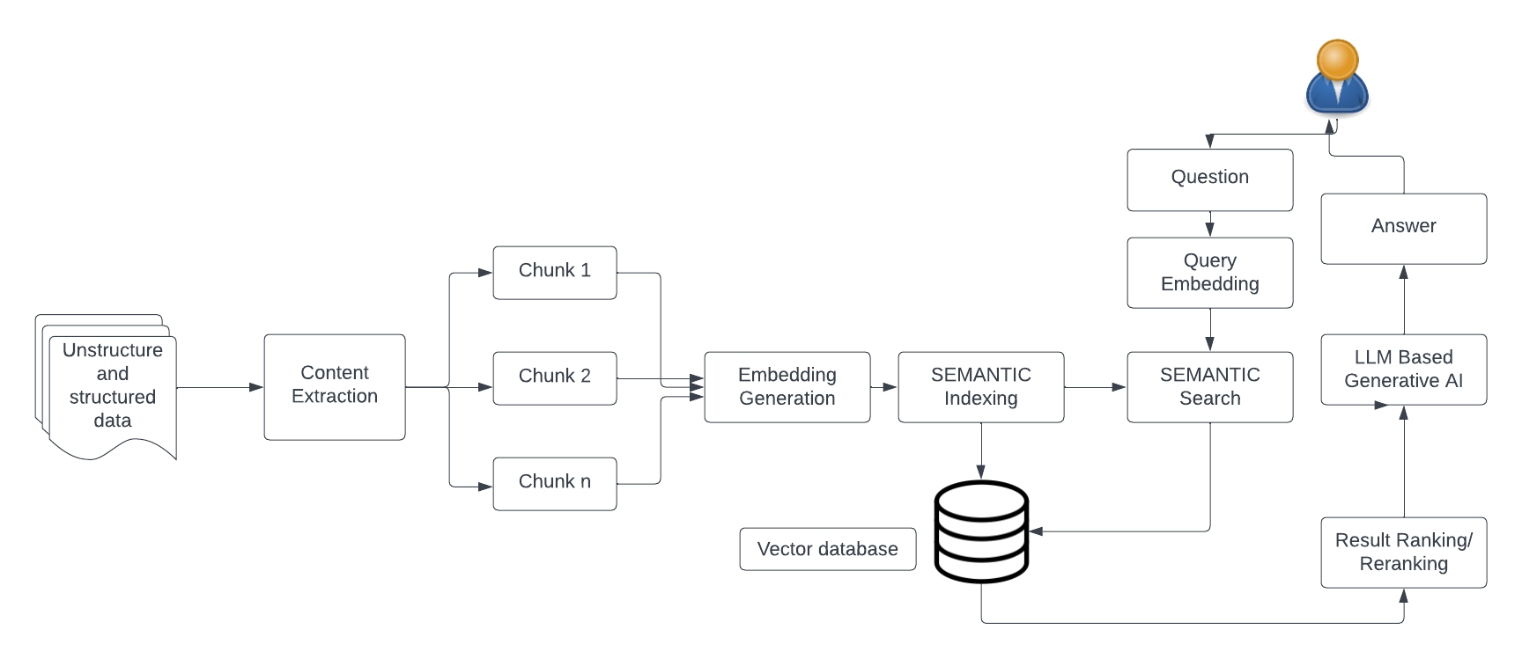
Flow chart

Slide 12


We combine Analytical Excellence with Tech Execution to deliver sustainable
value ​
Our core value proposition
We analyze messy operational, financial & customer data to identify process & performance improvement insights and execute them in business apps (ERP/SFDC/Bespoke)
Ability to extract, ingest and curate messy data from systems with minimal guidance
Build “Software Sensors” with Analytics & AI and deliver them via BI, Dashboards and Process Improvements
Diagnostics and AI driven enterprise process transformation in core systems
Our Toolkit & Partnerships
Our Offices & Team
We work as a business partner and have three engagement models (Turnkey Projects, Long Term Service Based Contracts and Implementation Projects)
AWS Consulting Partner, Microsoft Gold (DATA & AI), Unit4 FP&A, SFDC
New Jersey
Gurgaon
Jaipur
Pune
Houston
“We understand and anticipate the business needs and changes, reducing the burden on client teams”
120+ Employees

Slide 13





Delivering solutions across industries leveraging our Analytics & AI, Digital
Services and Core Systems Capabilities ​
17+ years of experience in helping businesses unlock value from data
MBA from IIT Kanpur
Ex-Head -Customer Insights & Sales Analytics at Walters Kluwer| Assistant Director - Data and Analytics, Strategy & Transactions at Ernst & Young | Citi | AVP – AI & MI – Barclays Corporate Banking | HSBC​
27+ years of experience in Large IT Transformation and Consulting.​
Expertise in Cloud based digital platforms like Salesforce, NetSuite, Velocity, Cloud sense, and Marketing Packages.​
Played key Technology and Consulting roles in Infosys, Accenture, Wipro, Tech Mahindra, TNS, etc.​
Vivek Gupta
25+ years of Experience in AI, Analytics & Management Consulting
PhD from IM Ahmedabad
Ex-Partner, EY - Advisory Services |Co-founder & Chief Scientist/Chief Innovation Officer at Essex Lake Group | VP of Analytics – Opera Solutions | HSBC, Inductis​
Vivek Gupta
25+ years of experience in , Management Consulting, Start-ups
MBA from IIM Ahmedabad
Ex-Director, Advisory Services & Customer Practice at Ernst & Young |Director & Head Exports at TGI Group| Principal Management Consulting at Accenture | Hindustan Unilever​
20+ years of BSFI Experience
MBA from IIM Ahmedabad
Ex-Director, Depository receipts at BNY Mellon
Ex- American Express
Ex- Citibank

Slide 14
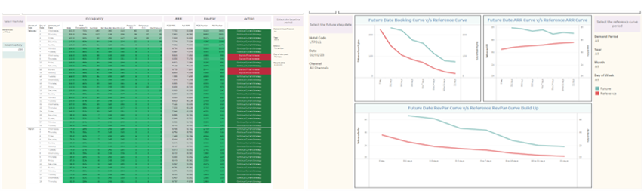
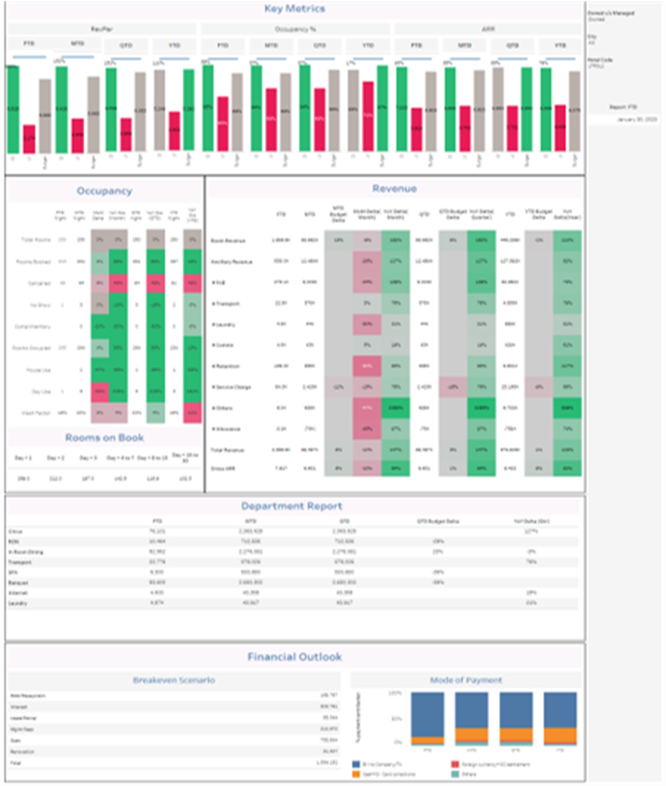
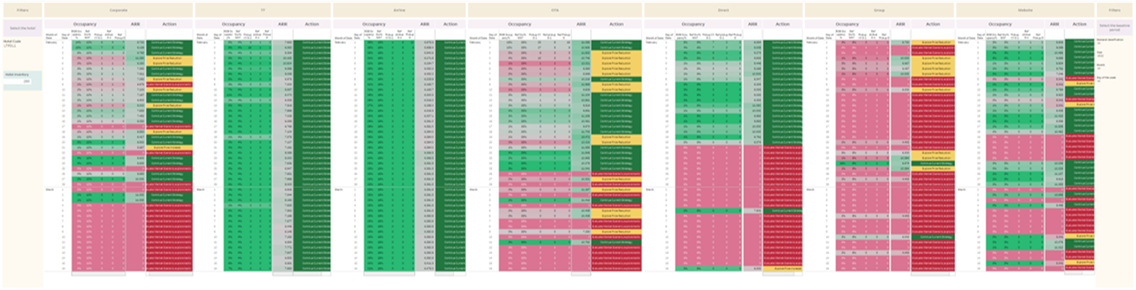
Profitability management solution for one of the largest hospitality players with 10000+ rooms and multiple systems 1/2
Situation​
A large chain of hotels with 10 brands and ~10000 rooms across 50 cities wanted to migrate the digital infrastructure to cloud environment. The management wanted to fast track creation of several business dashboards to support pricing, cost management, and the critical visibility/AI needed to run an efficient/effective enterprise.
Revenue Management Dashboards
Solution
We built and configured a complete cloud infrastructure on AWS cloud. Built a solution for lift and shift of the data from 10+ systems with 100+ databases and up to 30K tables to one unique space, and architect a system foundation that incrementally absorbed more tables and refreshed the data.
Our team helped transform data from multiple into a single data table to create a single source of truth for revenue and performance dashboards.
Revenue Management Dashboard Summary
Hotel Performance Dashboard
Implementation Approach
Proof of Concept
Discovery
Solution Design
Data Replica on Cloud
Incremental Data Updates
Metrics & DWH Refresh
Plug & Play Dashboards
Access to different system databases test DB connections​ Data mapping and assessment​ Business and technical requirements, risks and challenges​ | Run querry to obtain data from source system to cloud​ Architectural design​ Security, scalability and performance management​ | Test data in virtual environment​ Data integrity, performance evaluation​ Migration time & error handling​ | Upload of external data files ​ Comprehensive validation and verification ​ | Ongoing daily data incremental uploads​ Flexibility to modify the frequency later​ Full refresh for some small-size master files ​ | Data-warehouse for custom analytics projects​ Historical metrics to allow trending over time​ KPI Calculation​ | Business overview report with field filters​ ​ Ability to pull the subset data in excel for further action​
App Architecture
Amazon SNS, AWS DMS
Amazon S3
AWS Glue, AWS Lambda
Amazon Redshift, Py Spark
Tableau

Slide 15
Profitability management solution for one of the largest hospitality players with 10000+ rooms and multiple systems 1/2
Situation​
A large chain of hotels with 10 brands and ~10000 rooms across 50 cities wanted to migrate the digital infrastructure to cloud environment. The management wanted to fast track creation of several business dashboards to support pricing, cost management, and the critical visibility/AI needed to run an efficient/effective enterprise.
Revenue Management Dashboards
Solution
We built and configured a complete cloud infrastructure on AWS cloud. Built a solution for lift and shift of the data from 10+ systems with 100+ databases and up to 30K tables to one unique space, and architect a system foundation that incrementally absorbed more tables and refreshed the data.
Our team helped transform data from multiple into a single data table to create a single source of truth for revenue and performance dashboards.
Revenue Management Dashboard Summary
Hotel Performance Dashboard
Implementation Approach
Proof of Concept
Discovery
Solution Design
Data Replica on Cloud
Incremental Data Updates
Metrics & DWH Refresh
Plug & Play Dashboards
Access to different system databases test DB connections​ Data mapping and assessment​ Business and technical requirements, risks and challenges​ | Run querry to obtain data from source system to cloud​ Architectural design​ Security, scalability and performance management​ | Test data in virtual environment​ Data integrity, performance evaluation​ Migration time & error handling​ | Upload of external data files ​ Comprehensive validation and verification ​ | Ongoing daily data incremental uploads​ Flexibility to modify the frequency later​ Full refresh for some small-size master files ​ | Data-warehouse for custom analytics projects​ Historical metrics to allow trending over time​ KPI Calculation​ | Business overview report with field filters​ ​ Ability to pull the subset data in excel for further action​
App Architecture
Amazon SNS, AWS DMS
Amazon S3
AWS Glue, AWS Lambda
Amazon Redshift, Py Spark
Tableau

Slide 16
Profitability management solution for one of the largest hospitality players with 10000+ rooms and multiple systems 1/2
Situation​
A large chain of hotels with 10 brands and ~10000 rooms across 50 cities wanted to migrate the digital infrastructure to cloud environment. The management wanted to fast track creation of several business dashboards to support pricing, cost management, and the critical visibility/AI needed to run an efficient/effective enterprise.
Revenue Management Dashboards
Solution
We built and configured a complete cloud infrastructure on AWS cloud. Built a solution for lift and shift of the data from 10+ systems with 100+ databases and up to 30K tables to one unique space, and architect a system foundation that incrementally absorbed more tables and refreshed the data.
Our team helped transform data from multiple into a single data table to create a single source of truth for revenue and performance dashboards.
Revenue Management Dashboard Summary
Hotel Performance Dashboard
Implementation Approach
Proof of Concept
Discovery
Solution Design
Data Replica on Cloud
Incremental Data Updates
Metrics & DWH Refresh
Plug & Play Dashboards
Access to different system databases test DB connections​ Data mapping and assessment​ Business and technical requirements, risks and challenges​ | Run querry to obtain data from source system to cloud​ Architectural design​ Security, scalability and performance management​ | Test data in virtual environment​ Data integrity, performance evaluation​ Migration time & error handling​ | Upload of external data files ​ Comprehensive validation and verification ​ | Ongoing daily data incremental uploads​ Flexibility to modify the frequency later​ Full refresh for some small-size master files ​ | Data-warehouse for custom analytics projects​ Historical metrics to allow trending over time​ KPI Calculation​ | Business overview report with field filters​ ​ Ability to pull the subset data in excel for further action​
App Architecture
Amazon SNS, AWS DMS
Amazon S3
AWS Glue, AWS Lambda
Amazon Redshift, Py Spark
Tableau

Slide 17
Profitability management solution for one of the largest hospitality players with 10000+ rooms and multiple systems 1/2
Situation​
A large chain of hotels with 10 brands and ~10000 rooms across 50 cities wanted to migrate the digital infrastructure to cloud environment. The management wanted to fast track creation of several business dashboards to support pricing, cost management, and the critical visibility/AI needed to run an efficient/effective enterprise.
Revenue Management Dashboards
Solution
We built and configured a complete cloud infrastructure on AWS cloud. Built a solution for lift and shift of the data from 10+ systems with 100+ databases and up to 30K tables to one unique space, and architect a system foundation that incrementally absorbed more tables and refreshed the data.
Our team helped transform data from multiple into a single data table to create a single source of truth for revenue and performance dashboards.
Revenue Management Dashboard Summary
Hotel Performance Dashboard
Implementation Approach
Proof of Concept
Discovery
Solution Design
Data Replica on Cloud
Incremental Data Updates
Metrics & DWH Refresh
Plug & Play Dashboards
Access to different system databases test DB connections​ Data mapping and assessment​ Business and technical requirements, risks and challenges​ | Run querry to obtain data from source system to cloud​ Architectural design​ Security, scalability and performance management​ | Test data in virtual environment​ Data integrity, performance evaluation​ Migration time & error handling​ | Upload of external data files ​ Comprehensive validation and verification ​ | Ongoing daily data incremental uploads​ Flexibility to modify the frequency later​ Full refresh for some small-size master files ​ | Data-warehouse for custom analytics projects​ Historical metrics to allow trending over time​ KPI Calculation​ | Business overview report with field filters​ ​ Ability to pull the subset data in excel for further action​
App Architecture
Amazon SNS, AWS DMS
Amazon S3
AWS Glue, AWS Lambda
Amazon Redshift, Py Spark
Tableau

Slide 18


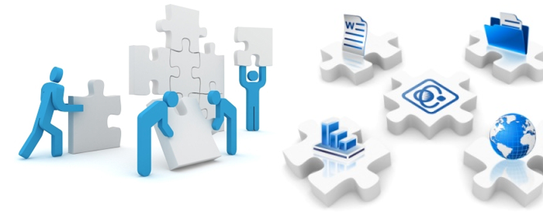
Delivering solutions across industries leveraging our Analytics & AI, Digital
Services and Core Systems Capabilities ​
ANALYTICS & AI
Data Engineering (AWS/Azure)
Dashboards, queries (Tableau / PowerBI)
Analytics (Python)
Computer Vision (DL), Personalization & Recommendation Engine
DIGITAL SERVICES
Web & Mobility Operations
Loyalty Management
O2C improvements
Automation/RPA
CORE SYSTEMS
FP&A – Unit 4
CRM - Salesforce.com
ERP - SAP, Unit4, NetSuite
Functional Areas
Sales & Marketing
CX
FP & A
O2C
P2P & Supply Chain
GRC
Customer 360, CLV, SFDC (next best offer), integrations, personalization
UX Designs, Apps, Conversational AI
Forecasting Models, Budget Optimization, KPI’s
AR, Revenue Assurance, CLM, Billing Improvements
Procurement, MDM, Control Towers
Risk & Fraud Algorithms, Credit / Collection Scores

Slide 19






The Leadership Team
Vivek Gupta
Rajat Sud
Joydeep Dutt
Abhishek Jain
Vikas Gupta
Co – Founder, CEO
SVP Banking & Financial
Executive Director & Partner
Leader & Partner
Technology Head & Partner
25+ years of Experience in AI, Analytics & Management Consulting
PhD from IM Ahmedabad
Ex-Partner, EY - Advisory Services |Co-founder & Chief Scientist/Chief Innovation Officer at Essex Lake Group | VP of Analytics – Opera Solutions | HSBC, Inductis​
20+ years of BSFI Experience
MBA from IIM Ahmedabad
Ex-Director, Depository receipts at BNY Mellon
Ex- American Express
Ex- Citibank
25+ years of experience in , Management Consulting, Start-ups
MBA from IIM Ahmedabad
Ex-Director, Advisory Services & Customer Practice at Ernst & Young |Director & Head Exports at TGI Group| Principal Management Consulting at Accenture | Hindustan Unilever​
17+ years of experience in helping businesses unlock value from data
MBA from IIT Kanpur
Ex-Head -Customer Insights & Sales Analytics at Walters Kluwer| Assistant Director - Data and Analytics, Strategy & Transactions at Ernst & Young | Citi | AVP – AI & MI – Barclays Corporate Banking | HSBC​
27+ years of experience in Large IT Transformation and Consulting.​
Expertise in Cloud based digital platforms like Salesforce, NetSuite, Velocity, Cloud sense, and Marketing Packages.​
Played key Technology and Consulting roles in Infosys, Accenture, Wipro, Tech Mahindra, TNS, etc.​

Slide 20
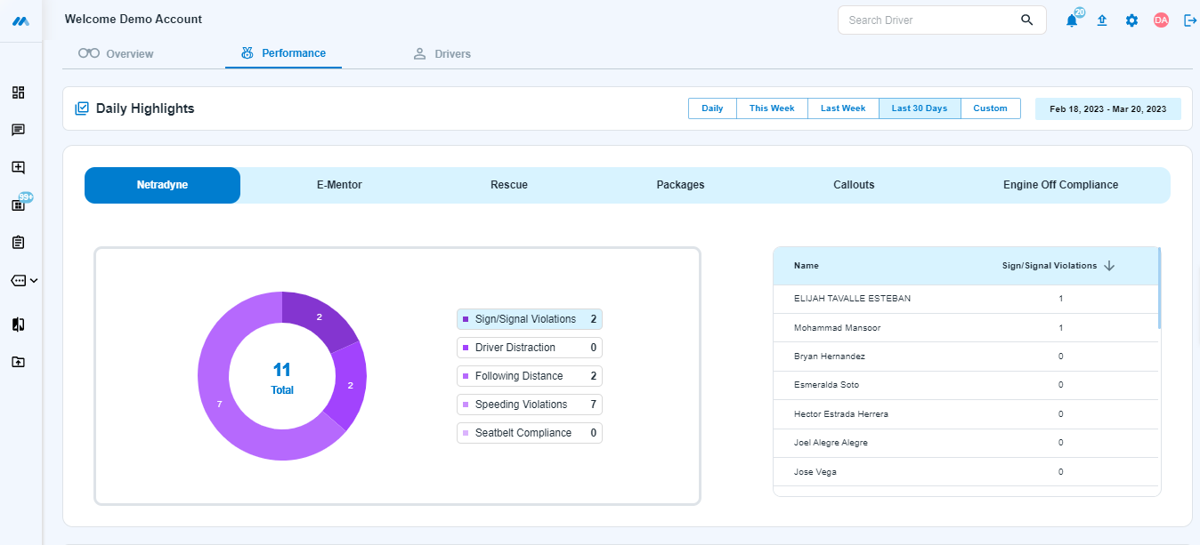
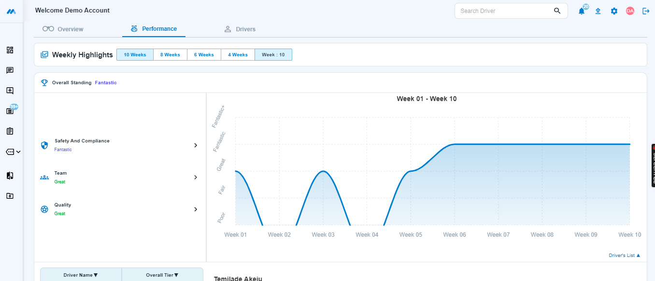
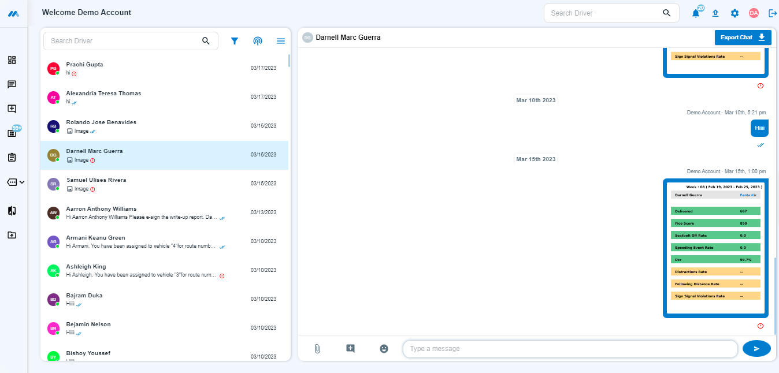
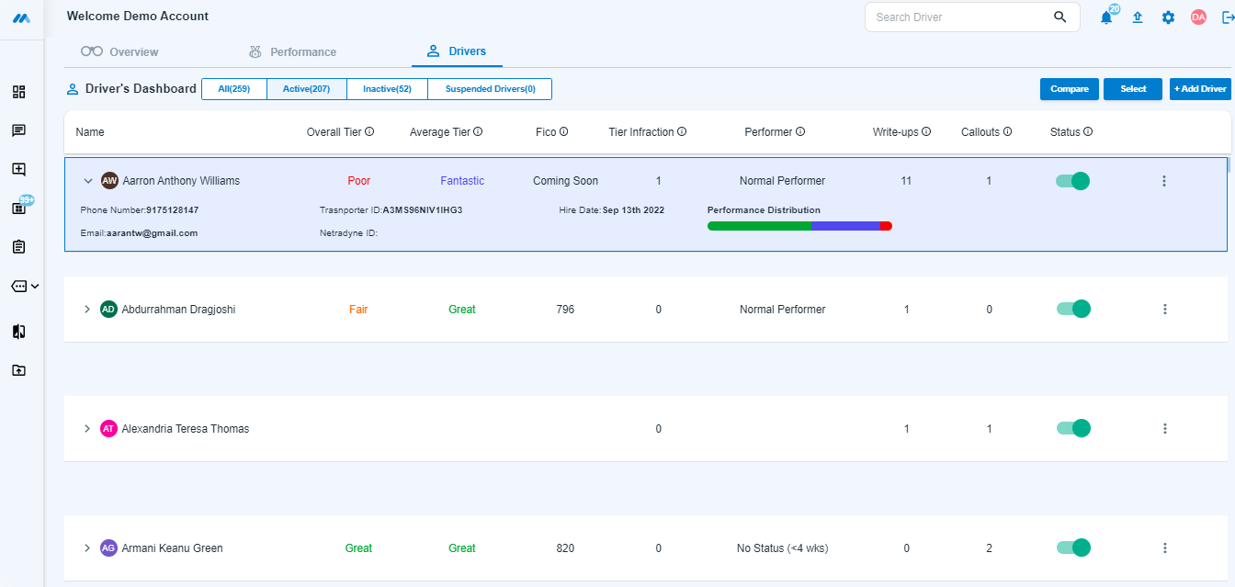
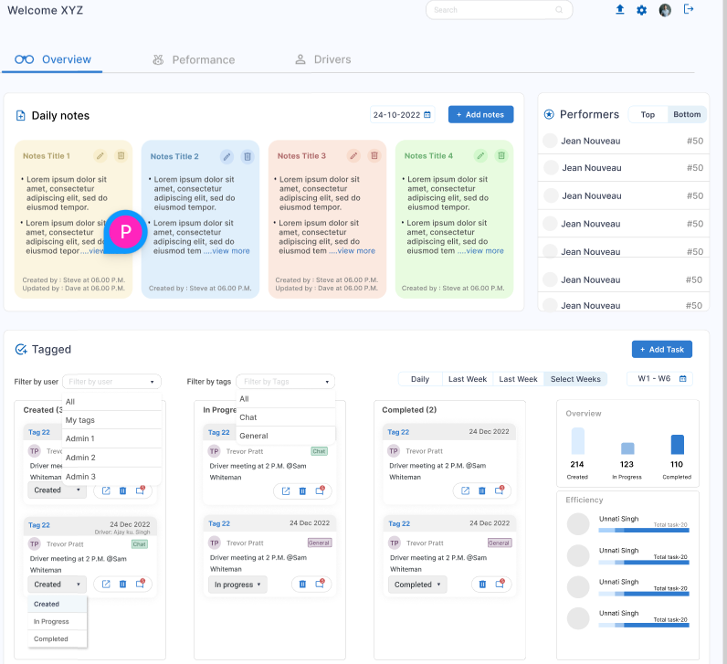
Data-driven performance and insurance improvement apps 1/2
Situation – A service provider servicing 200+ logistics companies wanted to build a platform for improving performance of the drivers and fleet management using data analytics, AI and IOT.
Solution – Every day about 10000+ vans leave their stations and distribute millions of packages. This platform manages the fleet and 25K+ drivers in the platform which is –
Complete analytical system to absorb a large amount of data on daily basis from multiple sources, IOTs, video and image data to generate driver scores, performance and fleet repair signal
Algorithm based master data management to handle unclean and noisy data
Mathematical and AI modeling of damages for estimation and monitoring
Completely customizable platform
App Architecture –
AWS based platform with mobile apps (Dispatcher app, Driver App, Repair tech App)
Communication platform (Twilio)
Amazon CloudWatch, ELB, Amazon Route S3
NAT Gateway, Amazon ECS, EKS
Dashboard and mobile-based data displays (Grafana, Prometheus, Redis)
Dashboard – Daily Data and Analytics
Dashboard – Weekly Data and Analytics
Communication – Chat & Broadcast Message
Driver's Performance & Management
Personalized Section for Notes and Task assignment

Slide 21
Data-driven performance and insurance improvement apps 1/2 ​
Situation​
A service provider servicing 200+ logistics companies wanted to build a platform for improving performance of the drivers and fleet management using data analytics, AI and IOT.
Solution
Every day about 10000+ vans leave their stations and distribute millions of packages. This platform manages the fleet and 25K+ drivers in the platform which is –
Complete analytical system to absorb a large amount of data on daily basis from multiple sources, IOTs, video and image data to generate driver scores, performance
Algorithm based master data management to handle unclean and noisy data
Completely customizable platform
Dashboard – Daily Data and Analytics
Dashboard – Weekly Data and Analytics
Communication – Chat & Broadcast Message
Driver's Performance & Management
App Architecture
AWS based platform with mobile apps
Communication platform (Twilio)
Amazon CloudWatch, ELB, Amazon Route S3
NAT Gateway, Amazon ECS, EKS
Dashboard and mobile-based data displays (Grafana, Prometheus, Redis)
Personalized Section for Notes and Task assignment

Slide 22
Data-driven performance and insurance improvement apps 1/2 ​
Situation​
A service provider servicing 200+ logistics companies wanted to build a platform for improving performance of the drivers and fleet management using data analytics, AI and IOT.
Solution
Every day about 10000+ vans leave their stations and distribute millions of packages. This platform manages the fleet and 25K+ drivers in the platform which is –
Complete analytical system to absorb a large amount of data on daily basis from multiple sources, IOTs, video and image data to generate driver scores, performance
Algorithm based master data management to handle unclean and noisy data
Completely customizable platform
Dashboard – Daily Data and Analytics
Dashboard – Weekly Data and Analytics
Communication – Chat & Broadcast Message
Driver's Performance & Management
App Architecture
AWS based platform with mobile apps
Communication platform (Twilio)
Amazon CloudWatch, ELB, Amazon Route S3
NAT Gateway, Amazon ECS, EKS
Dashboard and mobile-based data displays (Grafana, Prometheus, Redis)
Personalized Section for Notes and Task assignment

Slide 23
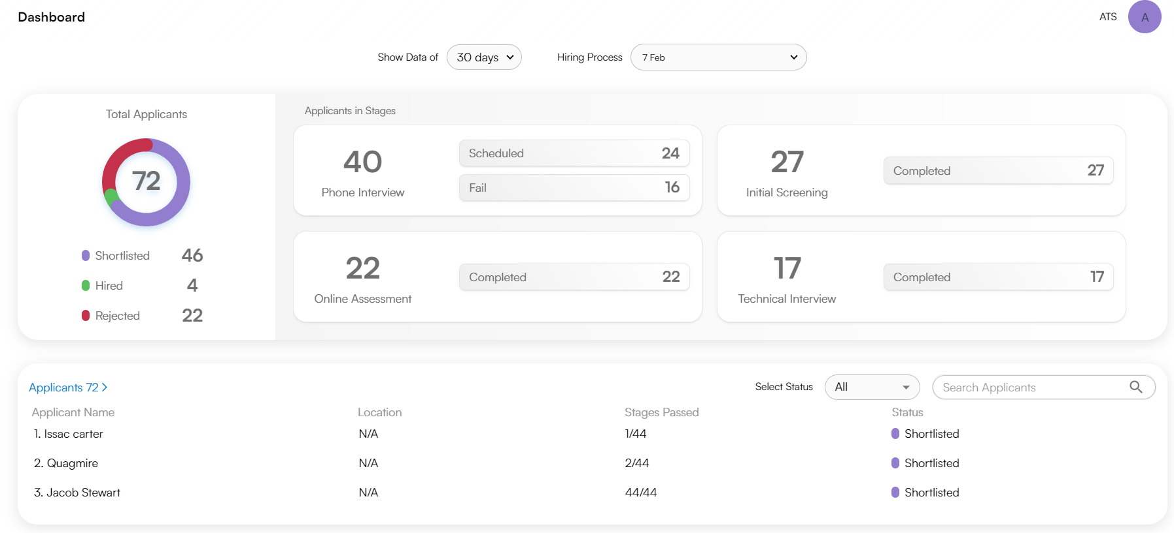
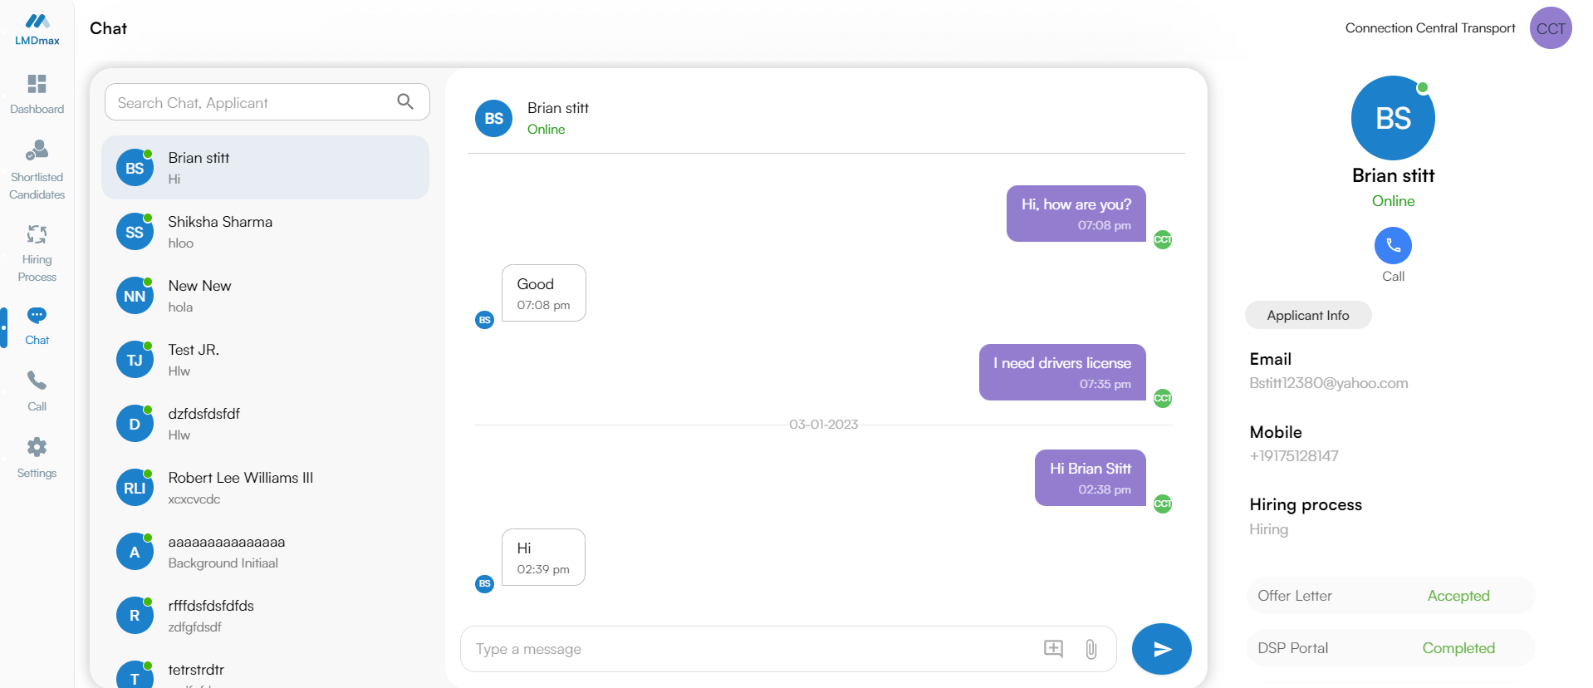
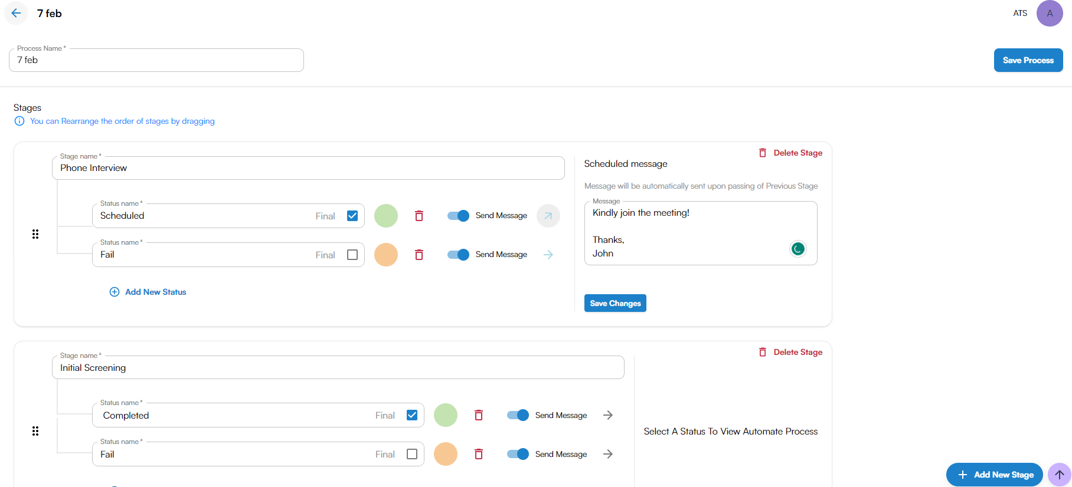
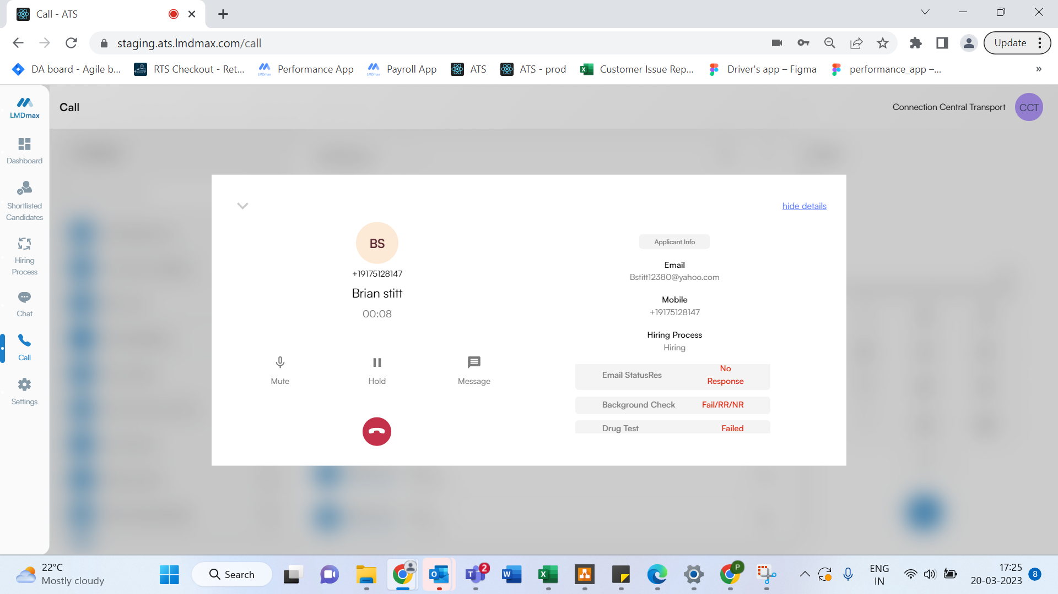
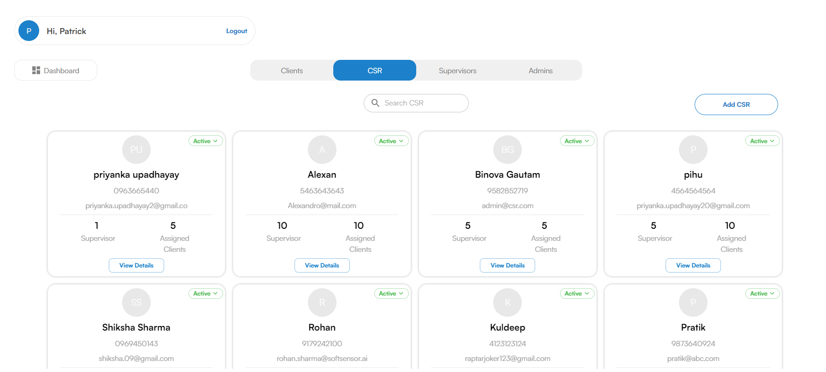
Driver Applications Hiring & Onboarding Platform 1/2
Situation – A service provide servicing 200+ logistics companies wanted to build a platform for hiring 10000+ drivers a year, onboard them on various systems, run background and KYC checks, and capture necessary tax credits, drug testing details
Solution – A team of 150+ associates call thousands of potential drivers who apply for jobs via portal, publish their jobs and communicate to complete the process
AWS based workflow system for managing gig economy hiring process
Communication platform using Twilio (Text + Calling) with A2P DC enabled for all the candidates
Rule Engine aur communication automation
Email alerts, scanning of documents using API for KYC, background checks
Customizable workflow
Management dashboards for managing the gaps in the workflow
Dialer support
Apps visibility for the customer
App Architecture -
AWS, Twilio,
Amazon CloudWatch, ELB, Amazon Route S3
NAT Gateway, EFS, EKS, ECR
Dashboard – Daily Data and Analytics
Communication Channel – Message
Rule Engine for System Automation
Communication Channel – Calling
Role-Based Distribution

Slide 24
Data-driven performance and insurance improvement apps 1/2 ​
Situation​
A service provide servicing 200+ logistics companies wanted to build a platform for hiring 10000+ drivers a year, onboard them on various systems, run background and KYC checks, and capture necessary tax credits, drug testing details
Solution
A team of 150+ associates call thousands of potential drivers who apply for jobs via portal, publish their jobs and communicate to complete the process
AWS based workflow system for managing gig economy hiring process
Communication platform using Twilio (Text + Calling) with A2P DC enabled for all the candidates
Rule Engine aur communication automation
Email alerts, scanning of documents using API for KYC, background checks
Customizable workflow
Management dashboards for managing the gaps in the workflow
Dialer support
Apps visibility for the customer
Dashboard – Daily Data and Analytics
Communication Channel – Message
Rule Engine for System Automation
Communication Channel – Calling
App Architecture
AWS, Twilio,
Amazon CloudWatch, ELB, Amazon Route S3
NAT Gateway, EFS, EKS, ECR
Role-Based Distribution

Slide 25
Data-driven performance and insurance improvement apps 1/2 ​
Situation​
Lymphoma detection is often slow and delayed. There are usually subtle differences in histologic findings between various types of lymphomas, so pathologists' expertise is required, but the ultimate decision lies in the use of immunostaining. Traditional pathology methods are cumbersome, and samples cannot be shared between multiple users.
Solution
A team of 150+ associates call thousands of potential drivers who apply for jobs via portal, publish their jobs and communicate to complete the process
AWS based workflow system for managing gig economy hiring process
Communication platform using Twilio (Text + Calling) with A2P DC enabled for all the candidates
Rule Engine aur communication automation
Email alerts, scanning of documents using API for KYC, background checks
Customizable workflow
Management dashboards for managing the gaps in the workflow
Dialer support
Apps visibility for the customer
Dashboard – Daily Data and Analytics
Communication Channel – Message
Rule Engine for System Automation
Communication Channel – Calling
Role-Based Distribution
App Architecture
AWS, Twilio,
Amazon CloudWatch, ELB, Amazon Route S3
NAT Gateway, EFS, EKS, ECR

Slide 26
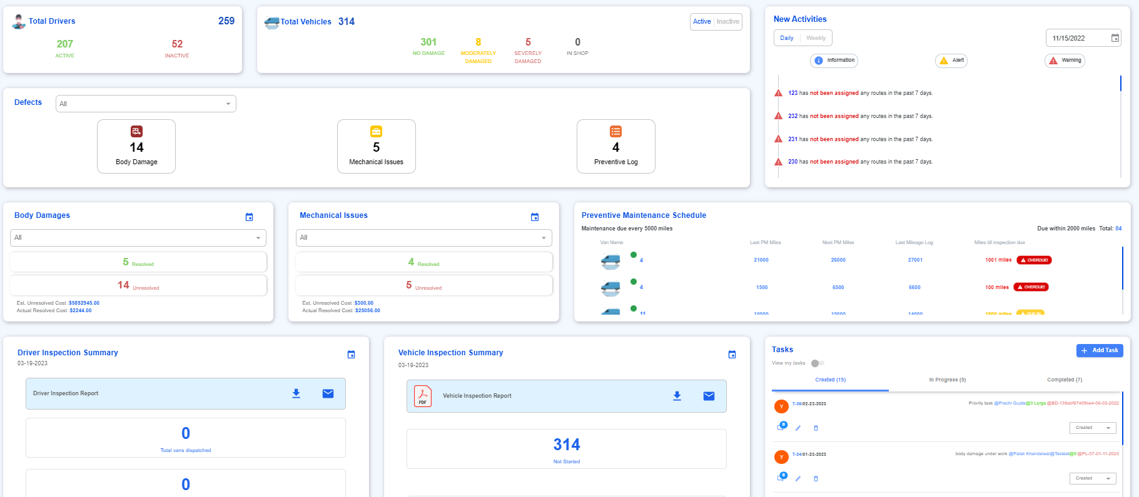
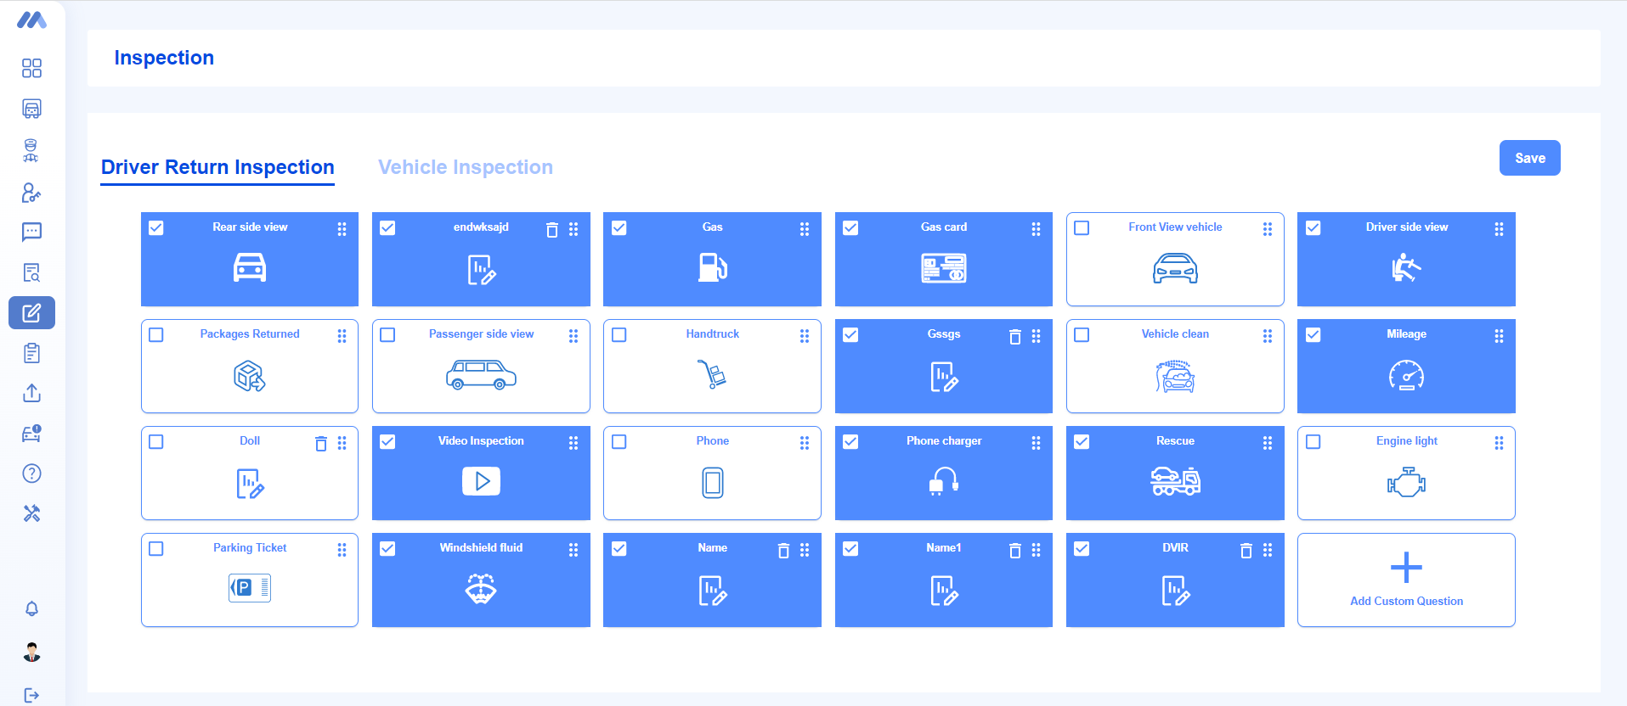
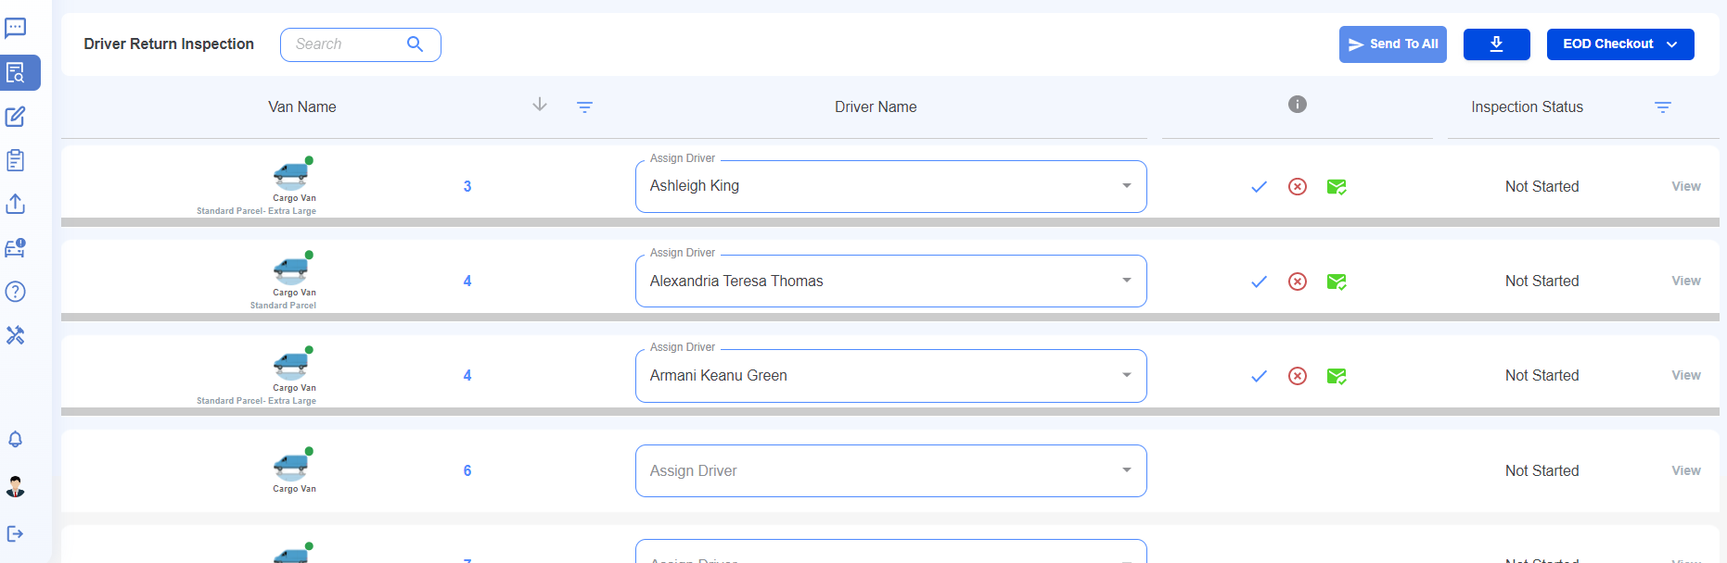
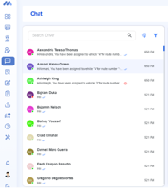
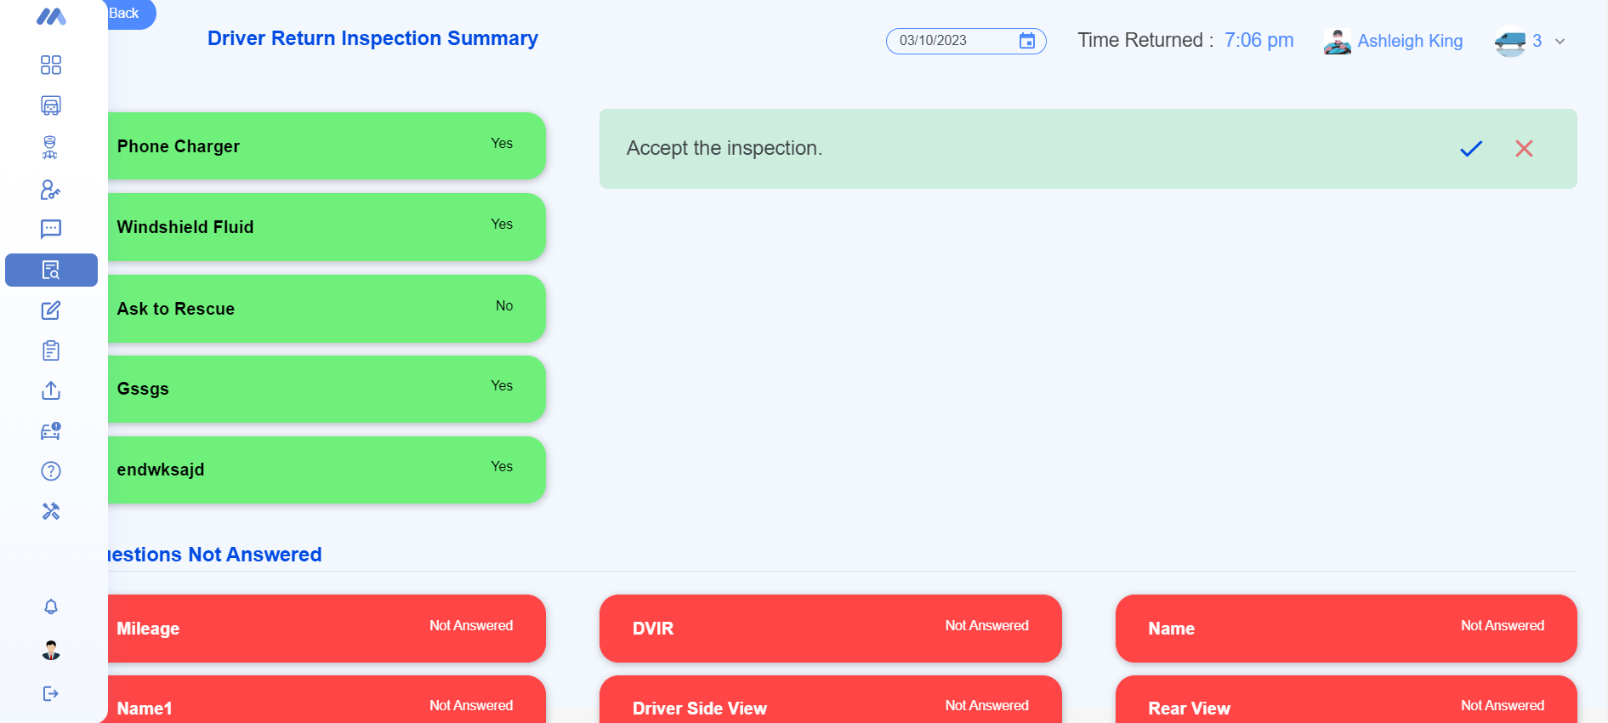
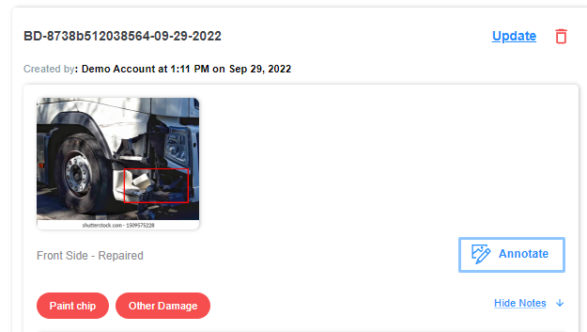
Fleet Management And Repair
Situation – A service provider servicing 200+ logistics companies wanted to build a platform for fleet and driver management using data analytics, AI and IOT.
Solution – Every day about 10000+ vans leave their stations and distribute millions of packages. This platform manages the fleet and 25K+ drivers in the platform which is –
A dashboard to present data and analytics along with alerts that need attention
Van assignment to drivers and their scheduling for package delivery
Morning and evening vehicle inspection, damage and maintenance logs, etc.
Communicate with drivers in various ways – one on one messages, broadcast messages, bulk messages.
Completely customizable platform
App Architecture –
AWS based platform with mobile apps (Dispatcher app, Driver App, Repair tech App)
Communication platform (Twilio)
Amazon CloudWatch, ELB, Amazon Route S3
NAT Gateway, Amazon ECS, EKS
Dashboard and mobile-based data displays (Grafana, Prometheus, Redis)
Dashboard – Daily Alerts and Analytics
Inspection Questions
Morning Van Assignment
Driver Chat window
Evening Vehicle Inspection
Damage Annotation using AI

Slide 27
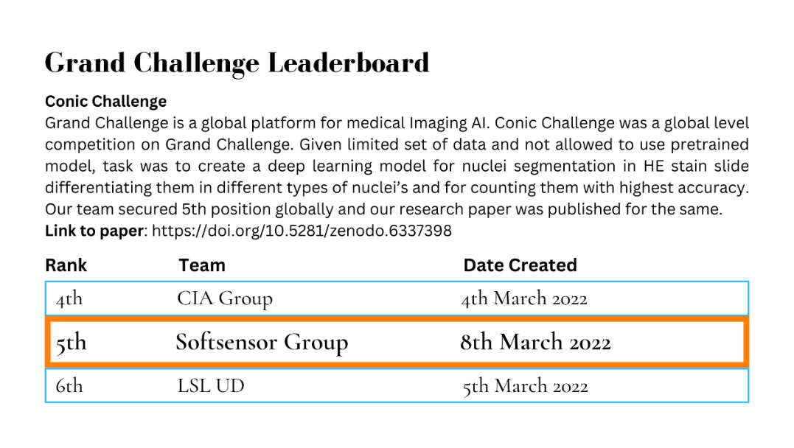
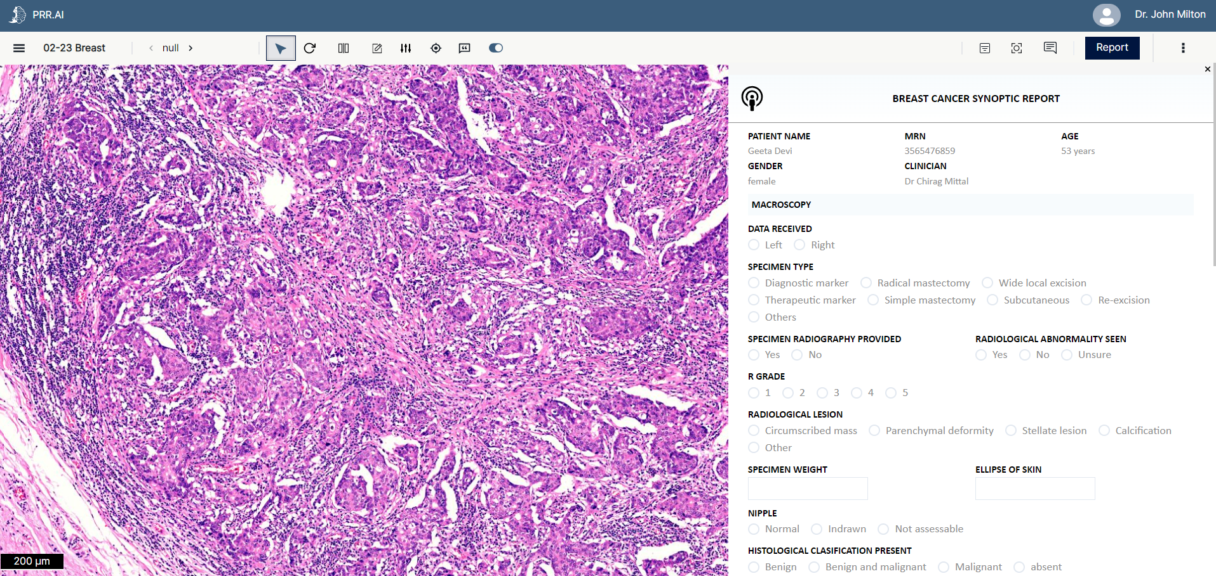
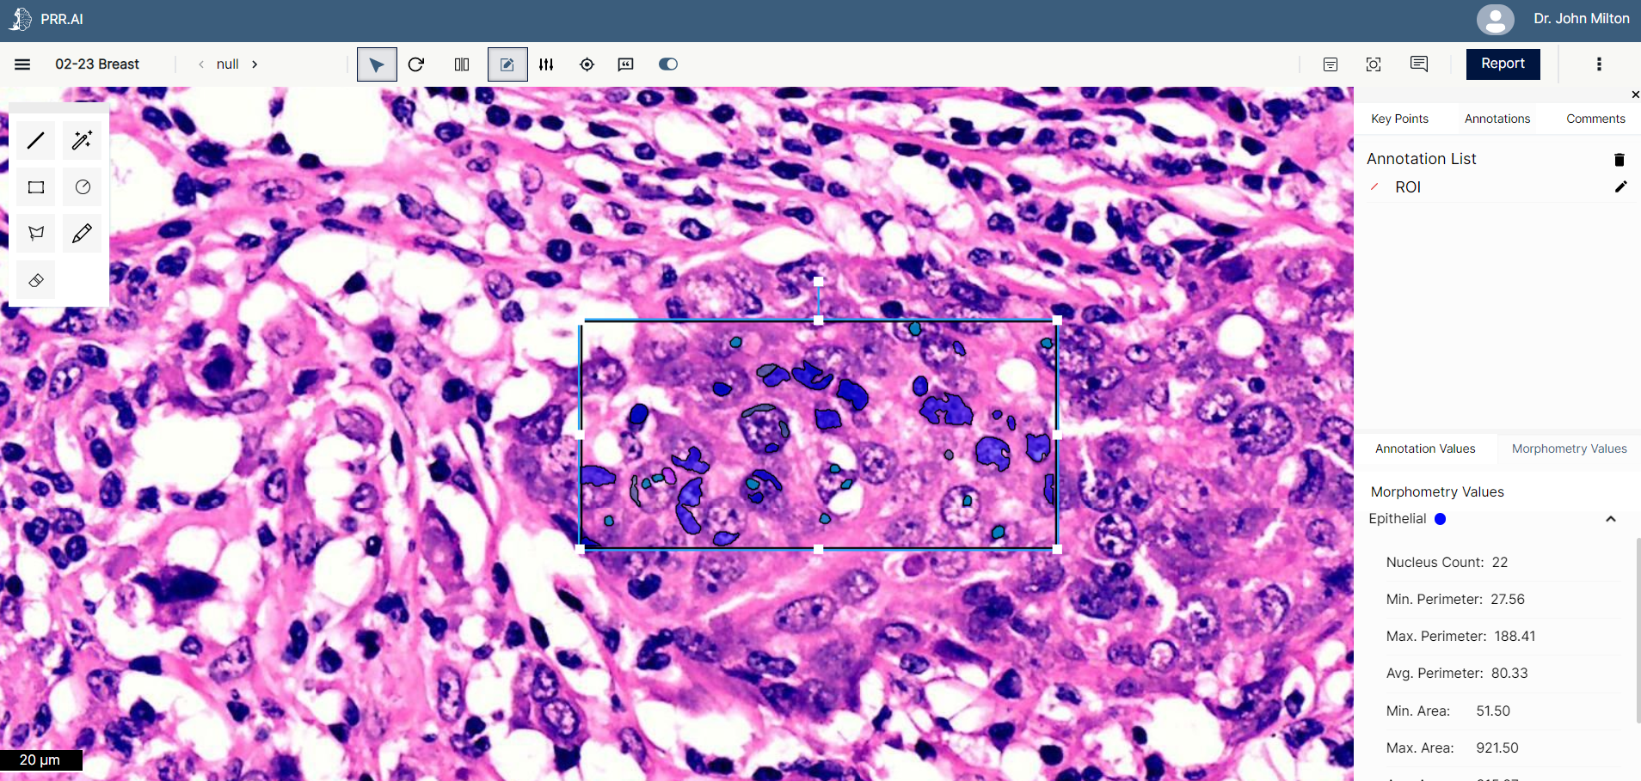
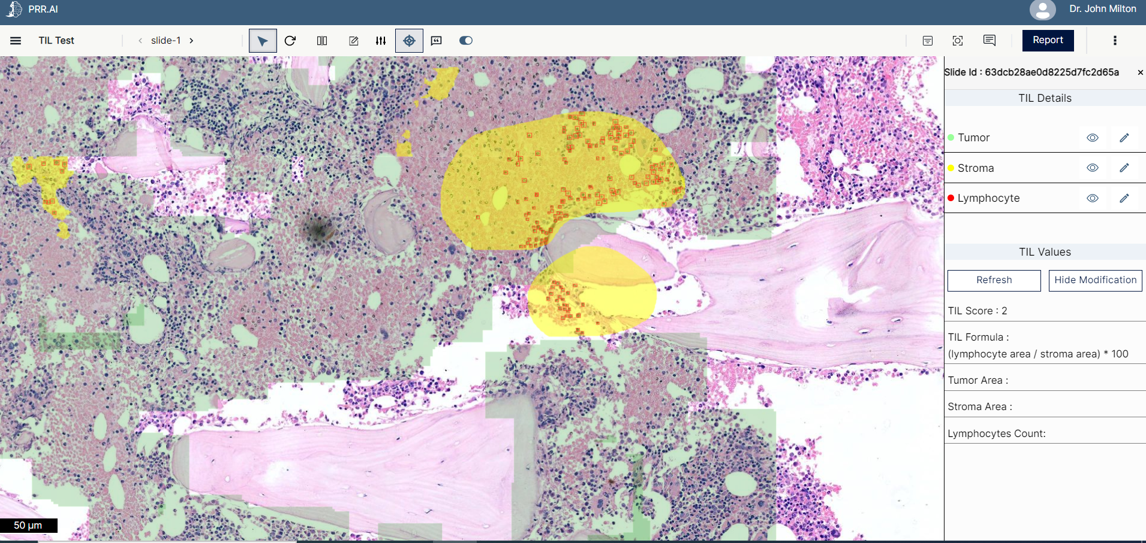
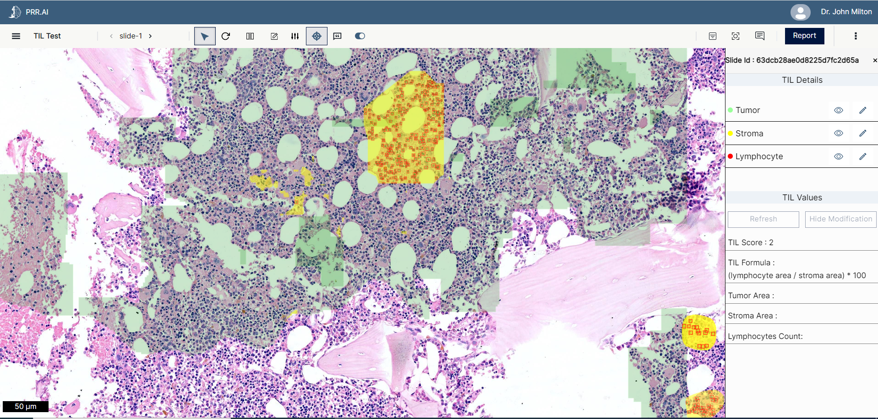
Computer Vision (AI – Deep learning) based platform for Oncological biomarkers with Digital Pathology workflows (Research/Lab/Teaching) 1/2
Situation
Lymphoma detection is often slow and delayed. There are usually subtle differences in histologic findings between various types of lymphomas, so pathologists' expertise is required, but the ultimate decision lies in the use of immunostaining. Traditional pathology methods are cumbersome, and samples cannot be shared between multiple users.
Solution
We built our own product, an integrated platform that allows the digitization of diagnostic slides using ML/AI-augmented predictions. It is under deployment with leading labs, hospitals, and technology institutions for oncology and liver biopsy AI workflow,
Computer vision AI development and deployment on a digital pathology workflow with data privacy and security
Ability to deploy AI with a failsafe architecture (Human in the loop) with a Viewer workbench
Deep learning models for Biomarkers (TILs, Ki67) for breast cancer (precision medicine)
Gigapixel image management and zoom technologies
Workflow solution with customizations for different users (providers, labs and teaching institutions)
Viewer Workflow
Morphometry Workflow
App Architecture
MERN stack, Amazon S3, AWS, Python, OpenSEAdragon Graph QL
HIL Output
TIL Output

Slide 28
Computer algorithms for the automated assessment of tumor-infiltrating lymphocytes in breast cancer histopathology slides 1/2
Situation
In recent years, several studies have shown the predictive and prognostic value of visually scored TILs in BC as well as in other cancer types, making TILs a powerful biomarker that can potentially be used in the clinic. Identifying and measuring TILs can help to better target treatments, particularly immunotherapy, and may result in lower levels of other more aggressive treatments, including chemotherapy.
Solution
We developed computer algorithms to analyze H&E-stained whole-slide images of breast cancer histopathology, to perform three tasks:
Detection of lymphocytes and plasma cells, which are the main types of cells considered as tumor-infiltrating lymphocytes;
Segmentation of invasive tumor and tumor-associated stroma, which are the main tissue compartments considered when identifying relevant regions for the TILs;
3. Compute an automated TILs score, one score per slide, based on the output of detection and segmentation.
App Architecture
MERN stack, Neural Networks, CV, IR
UperNet2, VAN [3], Yolo V5 m, COCO json
SGD Optimizer, Cosine LR Scheduler

Slide 29




Computer algorithms for the automated assessment of tumor-infiltrating lymphocytes in breast cancer histopathology slides 1/2
Situation -​
In recent years, several studies have shown the predictive and prognostic value of visually scored TILs in BC as well as in other cancer types, making TILs a powerful biomarker that can potentially be used in the clinic. Identifying and measuring TILs can help to better target treatments, particularly immunotherapy, and may result in lower levels of other more aggressive treatments, including chemotherapy.
Solution Approach
Data Preprocessing
Architecture
Training
Fixing tumor and stroma mirror padding Stain normalization to increase data size Normalization of bounding box coordinates Data Augmentation | UperNet [2] architecture with visual attention network (VAN) [3] as the backbone, to enable self-adaptive and long-range correlations in self attention. An FCN head as the auxiliary network is also added, and the outputs of both heads were computed separately according to different loss functions and added together as the total loss | Reduce classes into 1: tumor Optimize validation pipelines independently by observing dice over validation set. Select each optimal epoch from validation pipelines. CosineAnnealingWarmRestarts LR scheduling Heatmap of prediction results For Stroma, reduce classes into 1: stroma, Trained on MPP 2
Color Scale Normalization of bounding box coordinates which are input to yolov5 m model Data Augmentation | Yolo v5 m architecture with pretrained COCO json | Trained on MPP 0.5 OPTIMIZER: SGD (Stochastic Gradient Descent) Batch_size: 8 Epochs: 370 LR scheduler: Cosine LR
 | Combination of tumor segmentation, stroma segmentation and Lymphocyte Detection models | Otsu thresholding for differentiating between tissue and background. Introduced tumor model at first level which provides output as MPP 4. If output contains any region of tumor, pipeline further moves to Stroma Model at MPP 2. If output contains any region of stroma, pipeline further moves ahead with detection of lymphocytes. TIL Score is calculated as: Total Stromal area(tumor containing stroma)/total lymphocytes area)
Tumor &
Stroma Segmentation​
Solution -
We developed computer algorithms to analyze H&E-stained whole-slide images of breast cancer histopathology, to perform three tasks:
Detection of lymphocytes and plasma cells, which are the main types of cells considered as tumor-infiltrating lymphocytes;
Segmentation of invasive tumor and tumor-associated stroma, which are the main tissue compartments considered when identifying relevant regions for the TILs;
3. Compute an automated TILs score, one score per slide, based on the output of detection and segmentation.
Lymphocyte Detection
TILs
App Architecture
MERN Stack, Neural Networks, CV, IR
UperNet2, VAN [3], Yolo V5 m, COCO json
SGD Optimizer, Cosine LR Scheduler

Slide 30
Computer Vision (AI – Deep learning) based platform for Oncological biomarkers with Digital Pathology workflows (Research/Lab/Teaching) 1/2
Situation – Lymphoma detection is often slow and delayed. There are usually subtle differences in histologic findings between various types of lymphomas, so pathologists' expertise is required, but the ultimate decision lies in the use of immunostaining. Traditional pathology methods are cumbersome, and samples cannot be shared between multiple users.
Solution -
We built our own product, an integrated platform that allows the digitization of diagnostic slides using ML/AI-augmented predictions. It is under deployment with leading labs, hospitals, and technology institutions for oncology and liver biopsy AI workflow,
Computer vision AI development and deployment on a digital pathology workflow with data privacy and security
Ability to deploy AI with a failsafe architecture (Human in the loop) with a Viewer workbench
Deep learning models for Biomarkers (TILs, Ki67) for breast cancer (precision medicine)
Gigapixel image management and zoom technologies
Workflow solution with customizations for different users (providers, labs and teaching institutions)
App Architecture -
MERN stack, Amazon S3, AWS, Python, OpenSEAdragon Graph QL
Viewer Workflow
Morphometry Workflow
HIL Output
TIL Output

Slide 31

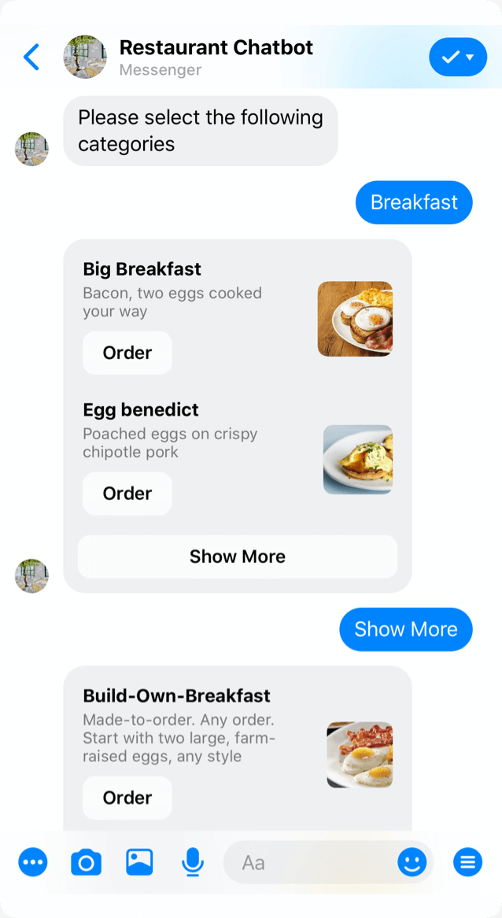



Graph based accelerator for IT Services Chatbot
Situation -
An IT product company was getting customer tickets and services issues which were causing challenges in growth. The company wanted to build a better routing of services request and build a self-service portal that can help customers in reducing their complaints.
Solution -
We gathered the last 24 months’ complaints and resolution data and used it to build a graph-based model for extracting steps in reaching a solution to a customer issue. We applied multiple NLP methods to extract relations, insights, and specific knowledge clusters, and merged them with ChatGPT API, and trained the model based on it. We used this to publish results to the services team for improving the training and products while using the graph-based model to quickly build chatbots and complimented them with conversation editors for enhancing the language and answers.
This allowed us to convert a long IT problem into a gamified version of knowledge discovery and chat solution development in the company. We implemented a continuous correction of information and updates at the client.
App Architecture -
A machine learning based system that automatically responds to customer queries and chatbots that act as virtual assistants and provide agent-like support to customers
Autoresponders & Chatbots
Reduced customer wait time
Use of graph technology to deliver quicker, faster chatbots
Reduced number of tickets for support agents
Reduced overall cost of service
Knowledge Graphs
N-gram analysis​
Naïve bayes, SVM and random forest​
LDA topic modelling

Slide 32
NLP Diagnostics for IT services helpdesk automation
Situation
A large membership organization with 4+ Mn members were getting tickets that needed to be routed for global working teams working in different time zones and at home.
Solution
Email data was captured from the systems and with their resolution over 3 months. Using NLP techniques, we analyzed the variety of ticket data and built a ticket routing system to allocate tickets to the right teams and queues.
We integrated the approach into their current ticketing platform (ZenDesk).
App Architecture
N-gram analysis
Naïve bayes, SVM and random forest
LDA topic modelling

Slide 33
NLP Diagnostics for IT services helpdesk automation
Situation -
A large membership organization with 4+ Mn members were getting tickets that needed to be routed for global working teams working in different time zones and at home.
Solution -
Email data was captured from the systems and with their resolution over 3 months. Using NLP techniques, we analyzed the variety of ticket data and built a ticket routing system to allocate tickets to the right teams and queues.
We integrated the approach into their current ticketing platform (ZenDesk).
App Architecture -
N-gram analysis
Naïve bayes, SVM and random forest
LDA topic modelling
Hardware
Login
Software
Payment
A machine learning based model that automatically classifies incoming customer complaints through mail, text or chat.
Automatic ticket triaging system
Reduced support agent time
Reduced cost of service
Increased efficiency
Highly accurate classification

Slide 34
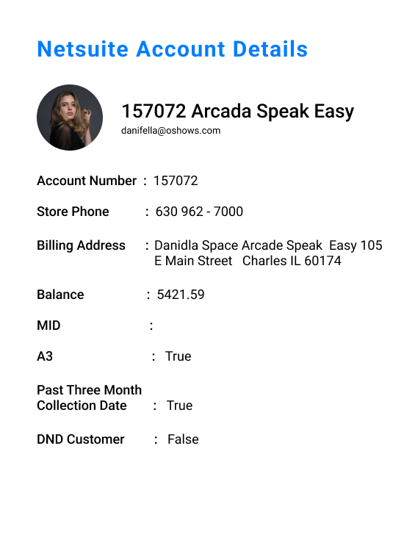
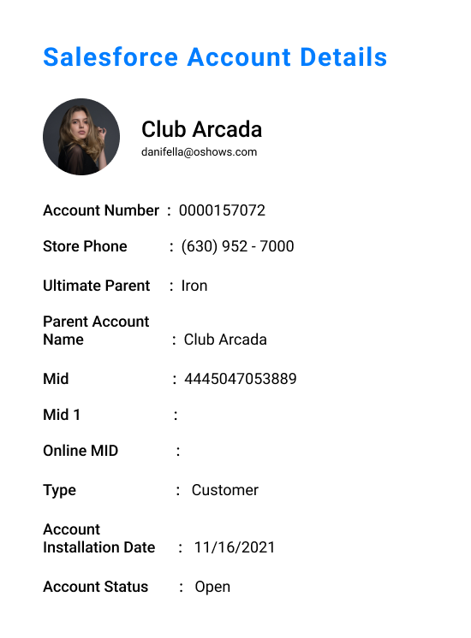
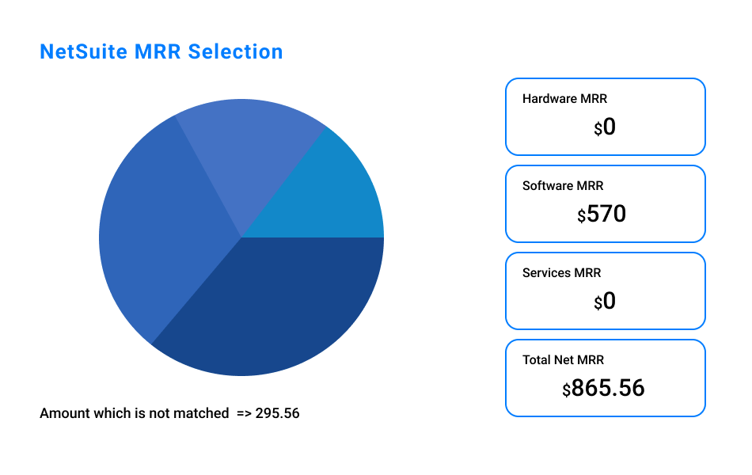
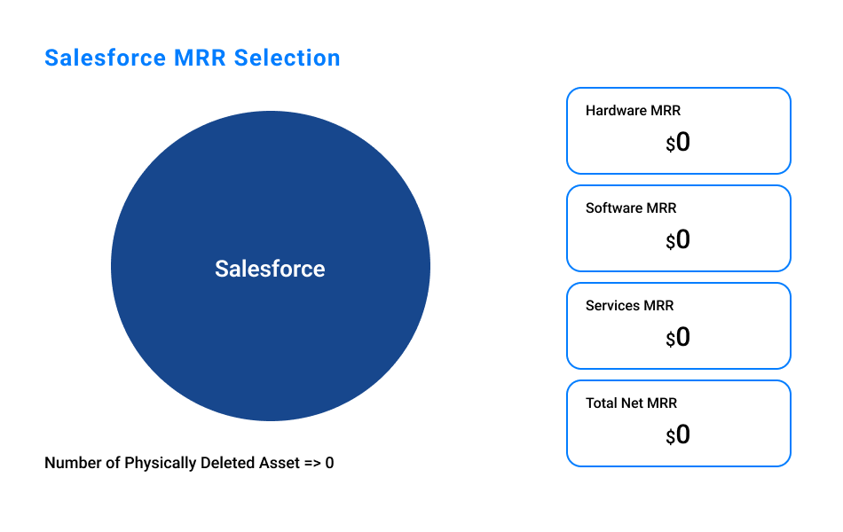
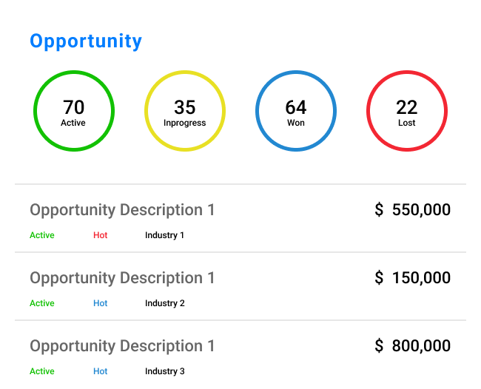
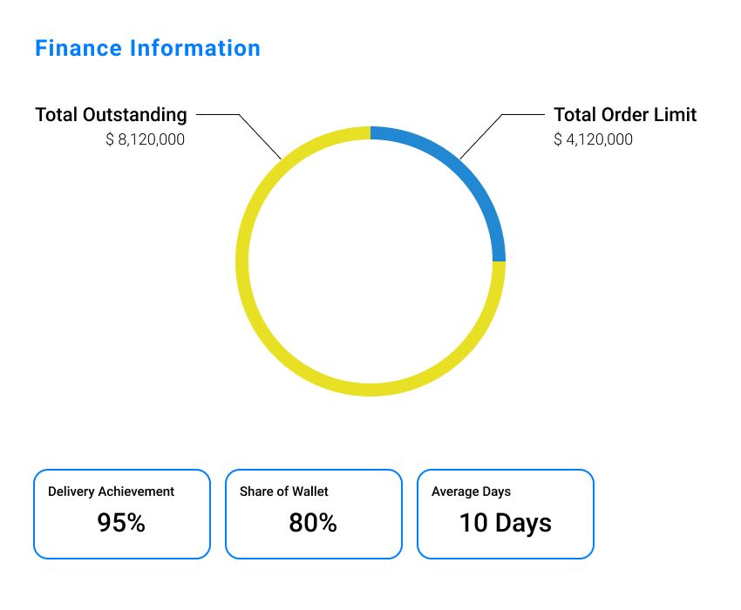
Data Lake Development for a Hospitality Client with Azure, Power BI Visualization and SFDC Implementation 1/2
Situation​ -
The customer had about 20,000 outlets generating orders, fulfilment, delivery, card payment data every day resulting in about 13Mn transactions a month ($500 Bn charge volume). Customer wanted to bring the disparate data to Cloud and produce a single view for management reporting on its key revenue sources, discounts and sales (both new and existing outlets as well as end customers)
Solution -
We delivered an integrated single view for management implemented on Azure cloud, and power BI. We also brought data from 20,000 outlets, online apps, SFDC, and NetSuite for customer 360 and provided multi-level views
Power BI Sales, Order, Customer, Restaurant, and Marketing views
Sales Summary, trends, Churn reporting, Loyalty Usage, Marketing Performance ROI
App Architecture -
Azure data lake, Power BI
Azure Function Apps, DataBricks, Eventgrid, App Service, and Power BI
SFDC, NetSuite Integration using Celigo
ID management across multiple systems
POWER BI at restaurant level for sales, billing, fulfilment, and revenues with collections

Slide 35
Data Lake Development for a Hospitality Client with Azure, Power BI Visualization and SFDC Implementation 1/2
Situation
The customer had about 20,000 outlets generating orders, fulfilment, delivery, card payment data every day resulting in about 13Mn transactions a month ($500 Bn charge volume). Customer wanted to bring the disparate data to Cloud and produce a single view for management reporting on its key revenue sources, discounts and sales (both new and existing outlets as well as end customers)
Solution
We delivered an integrated single view for management implemented on Azure cloud, and power BI. We also brought data from 20,000 outlets, online apps, SFDC, and NetSuite for customer 360 and provided multi-level views
Power BI Sales, Order, Customer, Restaurant, and Marketing views
Sales Summary, trends, Churn reporting, Loyalty Usage, Marketing Performance ROI
App Architecture
Azure data lake, Power BI
Azure Function Apps, DataBricks, Eventgrid, App Service, and Power BI
SFDC, NetSuite Integration using Celigo
ID management across multiple systems
POWER BI at restaurant level for sales, billing, fulfilment, and revenues with collections

Slide 36
Data warehousing and dashboarding for a large veterinary hospital network 1/2
Situation​ -
The client, building a regional hub and spoke model of veterinary hospitals required development of data warehouse and dashboards for Network/Clinic management. They wanted DWH on Microsoft Azure, and to route data from various practice management systems into the warehouse, and then build dashboards to monitor and display key performance indicators (KPIs) based on that data.
Implementation Approach
Phase 3 - Dashboards and Reports development
Phase1 - Data ETL to Azure
Phase 2 - Azure Data Lake and Data Warehouse
Discovery Solution design & development of data push/pull code Historical data migration Incremental solution and data validation, testing and reconciliation Alerts for exigencies | Data cleaning, transformation, and storage in separate structured data warehouse for historical KPI’s and metrics. Establishing key relationships Data quality & business logics Variable design & implementation Performance & cost optimization | Dashboard wireframing KPI and identification and validation Row level security for end-users Power BI python scripting configuration for certain users Automated dashboards on specific use cases and categories
Solution -
We delivered an integrated single view for management implemented on Azure cloud, and power BI. We also pulled the data from the existing AllyDVM platform using GraphQL API across 10+ systems into a central data lake on an Azure environment. We Developed Power BI dashboards for business analytics. Data Warehouse with specified KPI’s was then built using the Azure SQL Server and pulled into the developed Power BI dashboards for interactive business analytics.
App Architecture -
AllyDVM, GraphQL APIs
Azure data lake, Synapse Analytics, PySpark
Power BI

Slide 37
Data warehousing and dashboarding for a large veterinary hospital network 1/2
Situation
Implementation Approach
The client, building a regional hub and spoke model of veterinary hospitals required development of data warehouse and dashboards for Network/Clinic management. They wanted DWH on Microsoft Azure, and to route data from various practice management systems into the warehouse, and then build dashboards to monitor and display key performance indicators (KPIs) based on that data
Phase 3 - Dashboards and Reports development
Phase1 - Data ETL to Azure
Phase 2 - Azure Data Lake and Data Warehouse
Discovery Solution design & development of data push/pull code Historical data migration Incremental solution and data validation, testing and reconciliation Alerts for exigencies | Data cleaning, transformation, and storage in separate structured data warehouse for historical KPI’s and metrics. Establishing key relationships Data quality & business logics Variable design & implementation Performance & cost optimization | Dashboard wireframing KPI and identification and validation Row level security for end-users Power BI python scripting configuration for certain users Automated dashboards on specific use cases and categories
Solution
We delivered an integrated single view for management implemented on Azure cloud, and power BI. We also pulled the data from the existing AllyDVM platform using GraphQL API across 10+ systems into a central data lake on an Azure environment. We Developed Power BI dashboards for business analytics. Data Warehouse with specified KPI’s was then built using the Azure SQL Server and pulled into the developed Power BI dashboards for interactive business analytics.
App Architecture
AllyDVM, GraphQL APIs
Azure data lake, Synapse Analytics, PySpark
Power BI

Slide 38
Data warehousing and FP&A dashboarding for a healthcare provider network 1/2
Situation​ -
The client, building a network of mental healthcare facilities and managing their hospitals for providing the care, managing the stay, billing different insurances, capturing leads and following them up with the offer of services, wanted to set up data warehouse on Azure, and computation of FP&A dashboards. They also wanted to migrate all remaining data from Google Cloud Platform to Azure
Implementation Approach
Calculate metrics and refresh DWH
Data replica to cloud
Incremetal data update
Self-service dashboards and analytics
Custom built reports and support
Implement the Cloud architecture Pull historic data to cloud Build connectors to all the different source systems Validation and verification process | Ongoing daily data incremental uploads Full refresh for some small-size master files Automated data quality checksum and alert handling | Integrate data from various sources Build dimensions and key measures Clean up the data sources Calculate key performance indicators | Financial Summary LTM Financials Segment & consolidated financials Expense Details Corp Overhead Details EBITDA Bridge CFS Bridge Ability to filter and drill down | Summary KPI's BD KPI's ADC & Revenue Mix Any additional KPI's and metrics identified in discovery and requirements, discussions as feasible. User Training on self-serve dashboard. Data dictionary and documentation for data warehouse.
Solution -
We delivered an integrated single view for management implemented on Azure cloud, and power BI. We created a data warehouse to store the data in client-owned Azure environment, migrated all historical data from multiple systems, and created automated connectors and extracted the regular incremental data into the Azure environment.
We also built key financial reports and model for dashboards on Power BI.
App Architecture -
Azure Data Lake
Azure Synapse, Apache Spark
SQL Data Warehouse
Excel, Power BI

Slide 39
Data warehousing and dashboarding for a large veterinary hospital network 1/2
Situation
Implementation Approach
The client, building a regional hub and spoke model of veterinary hospitals required development of data warehouse and dashboards for Network/Clinic management. They wanted DWH on Microsoft Azure, and to route data from various practice management systems into the warehouse, and then build dashboards to monitor and display key performance indicators (KPIs) based on that data
Calculate metrics and refresh DWH
Data replica to cloud
Incremetal data update
Self-service dashboards and analytics
Custom built reports and support
Implement the Cloud architecture Pull historic data to cloud Build connectors to all the different source systems Validation and verification process | Ongoing daily data incremental uploads Full refresh for some small-size master files Automated data quality checksum and alert handling | Integrate data from various sources Build dimensions and key measures Clean up the data sources Calculate key performance indicators | Financial Summary LTM Financials Segment & consolidated financials Expense Details Corp Overhead Details EBITDA Bridge CFS Bridge Ability to filter and drill down | Summary KPI's BD KPI's ADC & Revenue Mix Any additional KPI's and metrics identified in discovery and requirements, discussions as feasible. User Training on self-serve dashboard.
Solution
We delivered an integrated single view for management implemented on Azure cloud, and power BI. We also pulled the data from the existing AllyDVM platform using GraphQL API across 10+ systems into a central data lake on an Azure environment. We Developed Power BI dashboards for business analytics. Data Warehouse with specified KPI’s was then built using the Azure SQL Server and pulled into the developed Power BI dashboards for interactive business analytics.
App Architecture
AllyDVM, GraphQL APIs
Azure data lake, Synapse Analytics, PySpark
Power BI

Slide 40
For a large pharma company, we built their budgeting and forecasting solution 1/2
Situation​ -
The client faced challenges in preparing their budgeting model, which was a combination of both bottom-up and top-down approaches. The top-down model did not consider some of the attributes in the bottom-up approach. They used different logics for actuals and forecasts, and some of the forecast logics were linked to actuals and had different versions of the data, there was no single source of truth, leading to inconsistencies in reporting.
System Snapshot
Solution -
With intensive planning and data-driven approach we built a unified platform for budgeting, forecasting, performance management, and variance analysis, eliminating the need for Excel-based reporting. The solution also included strategic planning, bottom-up/top-down approach, value-driver-based planning, rolling forecasts, AI-powered forecasting, scenario planning, inter-department communication, standard/ad-hoc analytics and reporting, board presentations, and report distribution across departments.
App Architecture -
Unit4 FP&A, Unit4 DSA
Azure Data Factory, Azure Data Lake, Azure Databricks

Slide 41
For a large pharma company, we built their budgeting and forecasting solution 1/2
Situation
System Snapshot
The client faced challenges in preparing their budgeting model, which was a combination of both bottom-up and top-down approaches. The top-down model did not consider some of the attributes in the bottom-up approach. They used different logics for actuals and forecasts, and some of the forecast logics were linked to actuals and had different versions of the data, there was no single source of truth, leading to inconsistencies in reporting.
Solution
With intensive planning and data-driven approach we built a unified platform for budgeting, forecasting, performance management, and variance analysis, eliminating the need for Excel-based reporting. The solution also included strategic planning, bottom-up/top-down approach, value-driver-based planning, rolling forecasts, AI-powered forecasting, scenario planning, inter-department communication, standard/ad-hoc analytics and reporting, board presentations, and report distribution across departments.
App Architecture
Unit4 FP&A, Unit4 DSA
Azure Data Factory, Azure Data Lake, Azure Databricks

Slide 42
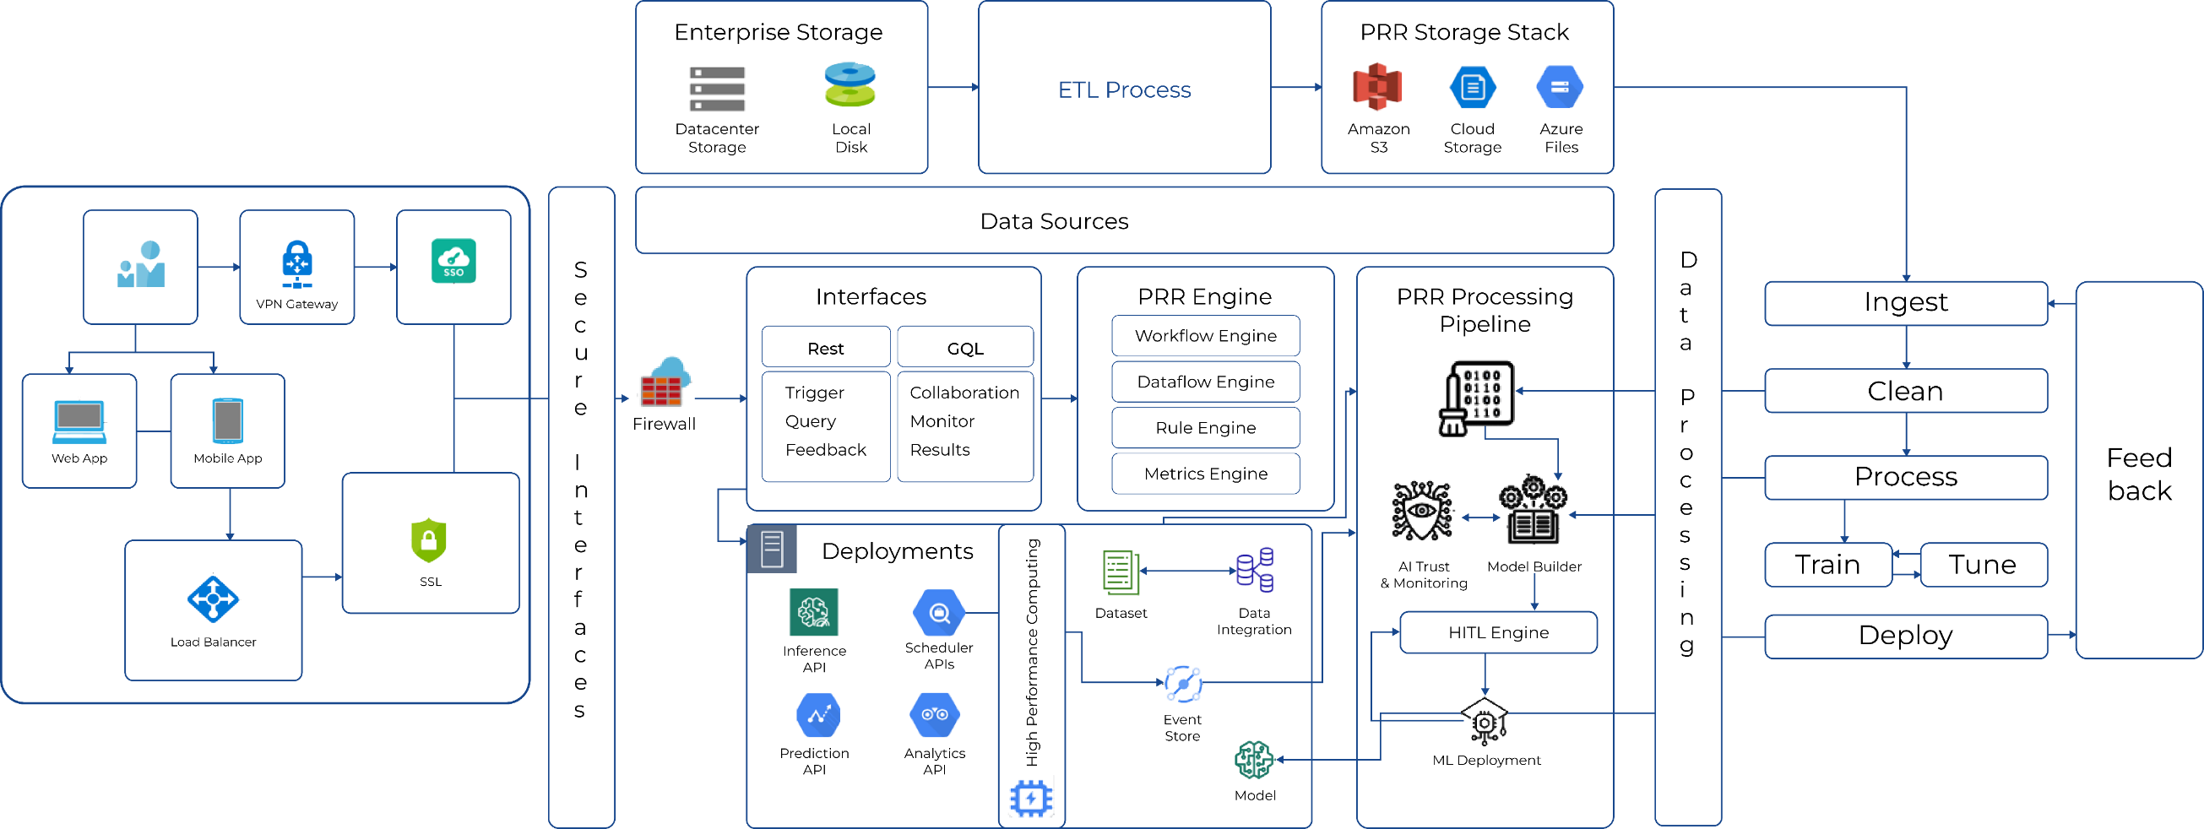
Computer Vision (AI – Deep learning) based platform for Oncological biomarkers with Digital Pathology workflows (Research/Lab/Teaching) 2/2
Architecture for the application

Slide 43
Driver Applications Hiring & Onboarding Platform 1/2
Dashboard – Daily Data and Analytics
Communication Channel – Message
Rule Engine for System Automation
Communication Channel – Calling
Role-Based Distribution

Slide 44





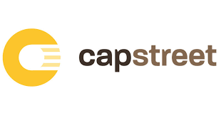






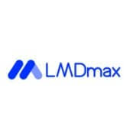


Our representative clients

Slide 45
Content

